Slide 1
No-Clamp Pendulum
Week 7

Slide 2
Why?
Eliminate effect of clamp
Try and understand new characteristic times.

Slide 3
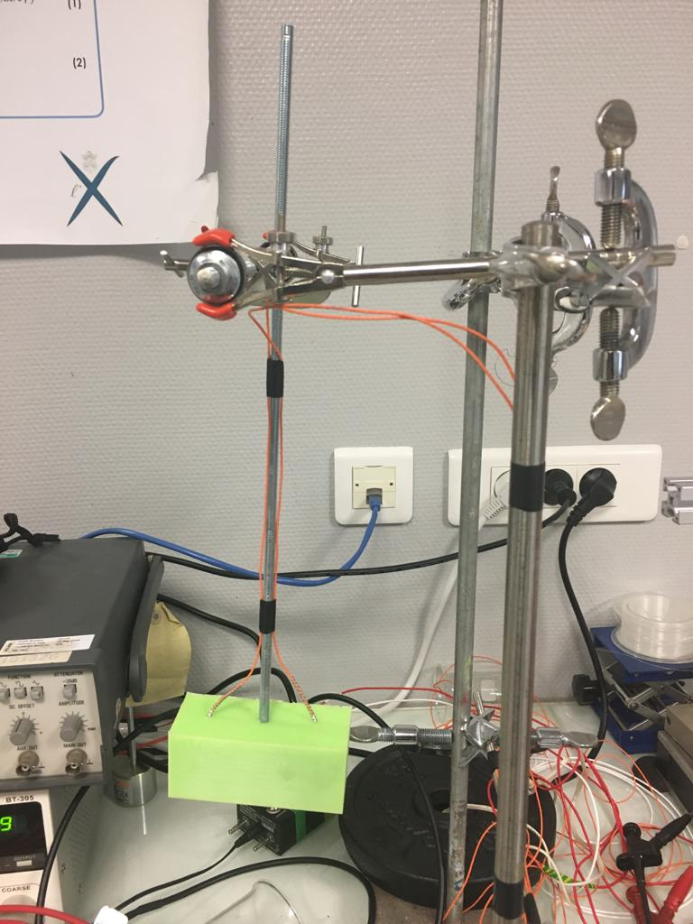
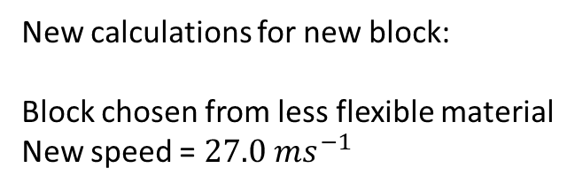
New experimental Set-up
New calculations for new block:
Block chosen from less flexible material
New speed = $27.0 ms^{−1}$

Slide 4
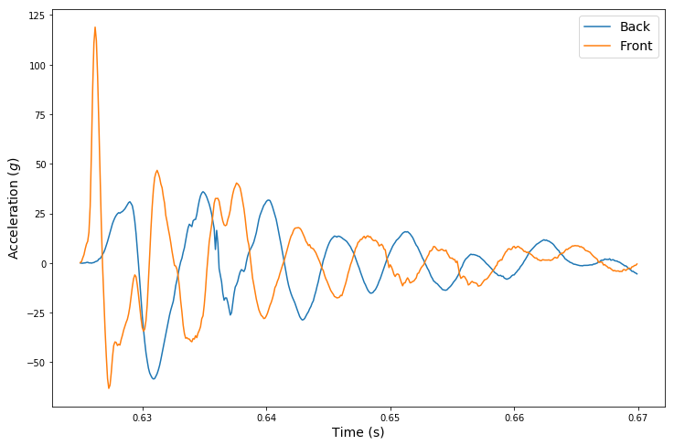
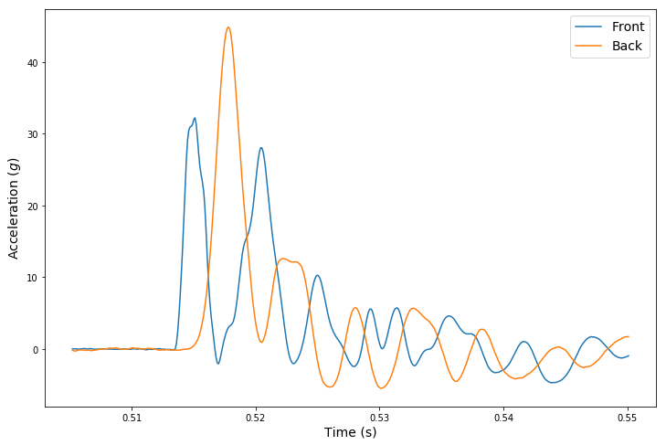
Example Data
Static
Dynamic

Slide 5
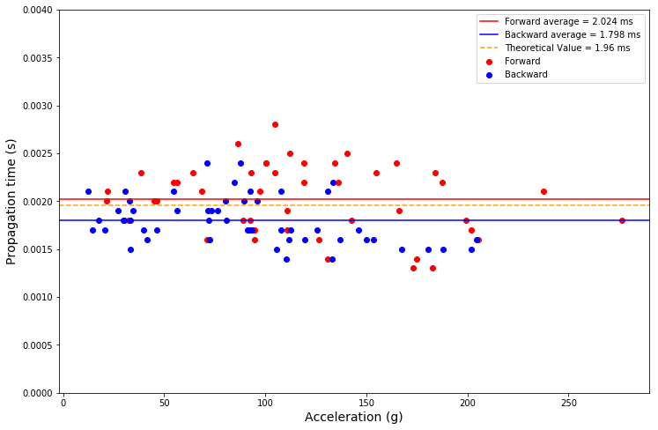
Propagation time - Static

Slide 6
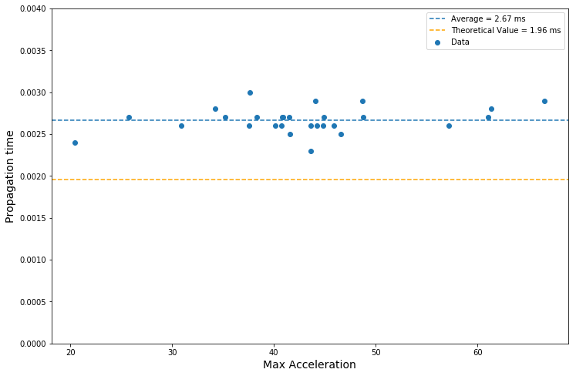
Propagation time - Dynamic

Slide 7
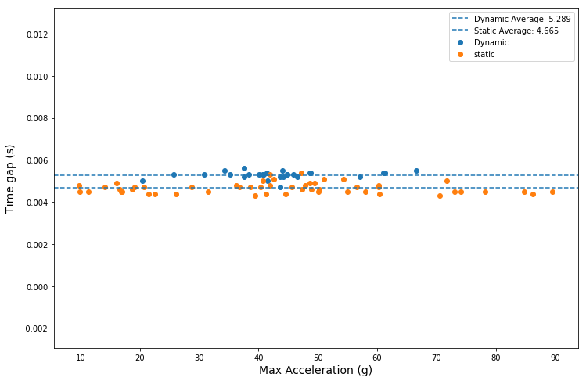
Gap between first two peaks

Slide 8
Questions
Why does propagation time change?
Static vs dynamic
Forward vs backwards
Finding theoretical value for time between first two peaks
Why different in dynamic?

Slide 9
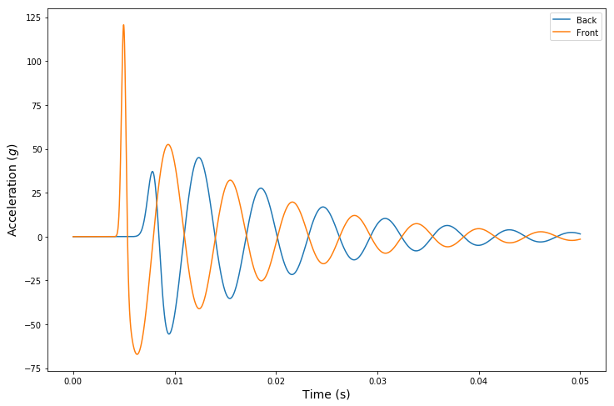
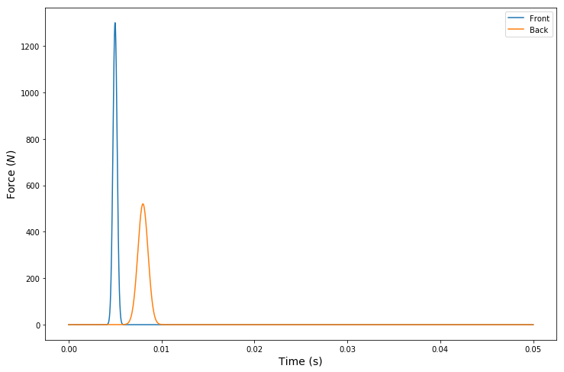
Comparison with model – static
Model based of gaussian force propagating through material.

Slide 10
Comparison with model – static
Model based of gaussian force, propagating through material.

Slide 11
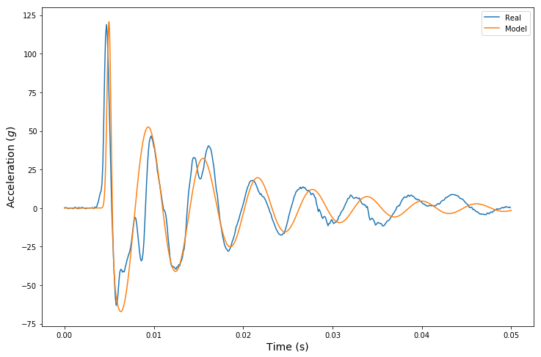
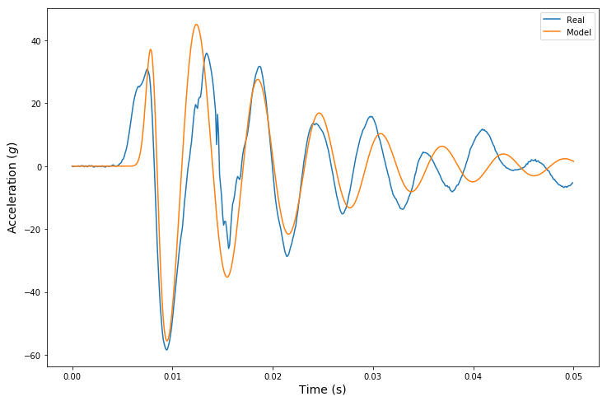
Comparison with model – static
Front
Back

